Slide 1
Biodiversity for the National Parks
By Michelle DeWald

Slide 2
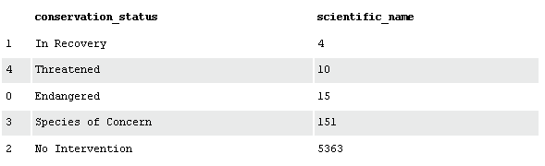
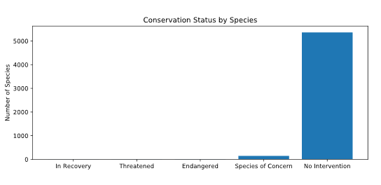
Conservation Status
Number of Species: 5,541
Categories: Mammal, Bird, Reptile, Amphibian, Fish, Vascular Plant, Nonvascular Plant
Conservation Statuses:
Most of the species requires no protection (5,363), while only 4 are in recovery. There are 151 species that are in need of conservation, and 25 that are close to extinction.

Slide 3
Percent of Protected
Category | Number of Not Protected | Number of Protected | Percent of Protected
Mammal | 146 | 30 | 17.05%
Bird | 413 | 75 | 15.37%
Reptile | 73 | 5 | 6.41%
Amphibian | 72 | 7 | 8.86%
Fish | 115 | 11 | 8.73%
Vascular Plant | 4216 | 46 | 1.08%
Nonvascular Plant | 328 | 5 | 1.50%

Slide 4
Comparing Species Categories
To compare differences in categorical data, we conducted two chi squared tests:
Test 1
The P-value of the difference between the percentages of protected Birds and Mammals: 68.76%
Test 2
The P-value of the difference between the percentages of protected Reptiles and Mammals: 3.84%
Conclusion: Birds and Mammals are more likely to become endangered than the other species. Conservationists should place their focus on these species next.

Slide 5
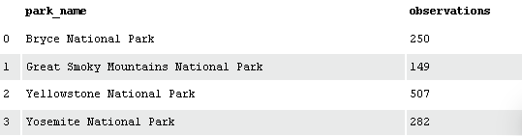
Observations of Sheep
According to our observations file it has been recorded that different species at several national parks have been sighted over the past 7 days.
The data has been added to only include mammal sheep species.
The observation data was then merged with the species data and grouped by National Park:

Slide 6
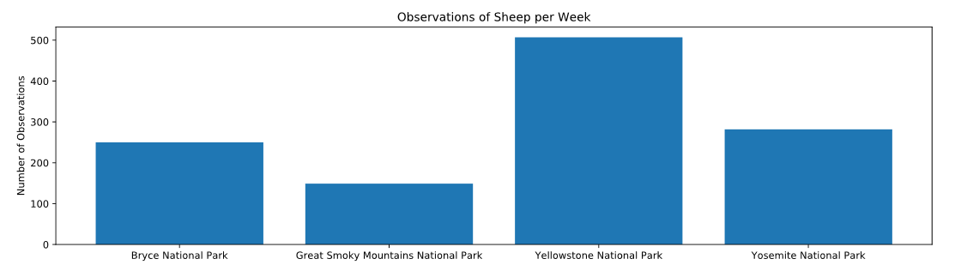
Yellowstone National Park saw the most sheep observations with 507 sightings out of the four parks.

Slide 7
Foot and Mouth Disease Study
A study was conducted among the parks’ Sheep on Foot and Mouth Disease.
Last year it was recorded that 15% of the sheep at Bryce National Park had Foot and Mouth disease.
Yellowstone National Park has been running a program to help reduce the rate of Foot and Mouth Disease and want to know if the program is working with a 5 percentage point reduction.

Slide 8
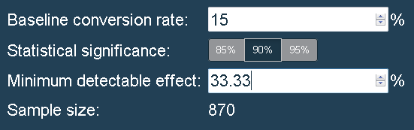
Foot and Mouth Disease A/B Test and Results
Observing in Yellowstone:
870/507 = 1.72 weeks
Observing in Bryce:
870/250 = 3.48 weeks

